Slide 1

Motion tracking system
Sunil Kumar Gummalla

Slide 2

Introduction
What?
Motion tracking assists in tracking the movement of objects and transferring the sensed data to an application for further processing.
Applications:
This has a wide range of applications such as in military, entertainment, sports, medical applications, validation of computer vision and robotics.
Domain : Smart Building
This motion tracking system can also help to detect fall and intrusions at homes or any commercial building with proper implementation.
Purpose : The current prototype sensor system detects the parameters and shares it to user through MQTT

Slide 3
Components
Devices: MPU6050 accelerometer and gyroscope sensor, ESP32 and a laptop
IOT Platform: connected over WiFi
MQTT broker: Mosquitto MQTT broker running on localhost
Coordinator: Node-red running on localhost
Database: MySQL database running on localhost
Webserver: Webserver like HTTP Grafana webserver running on localhost

Slide 4
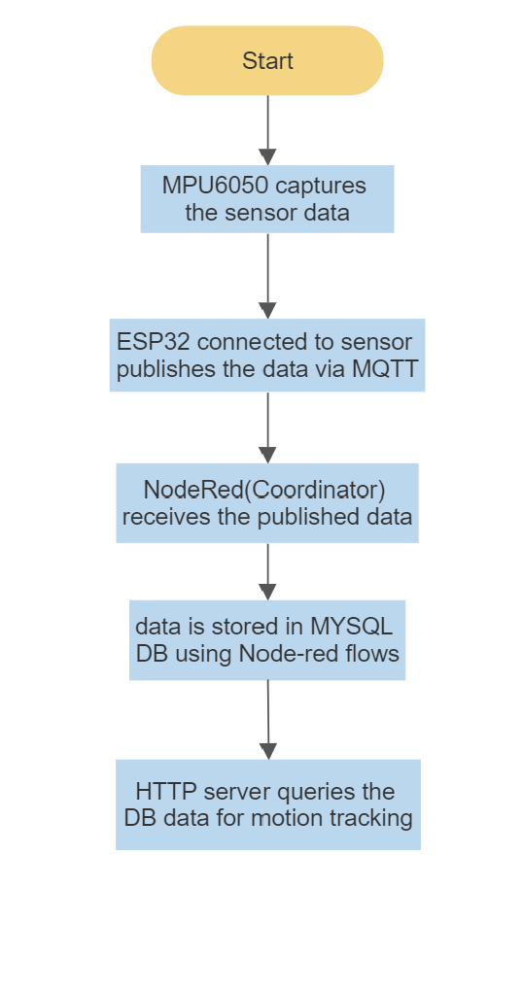
Process Specification

Slide 5
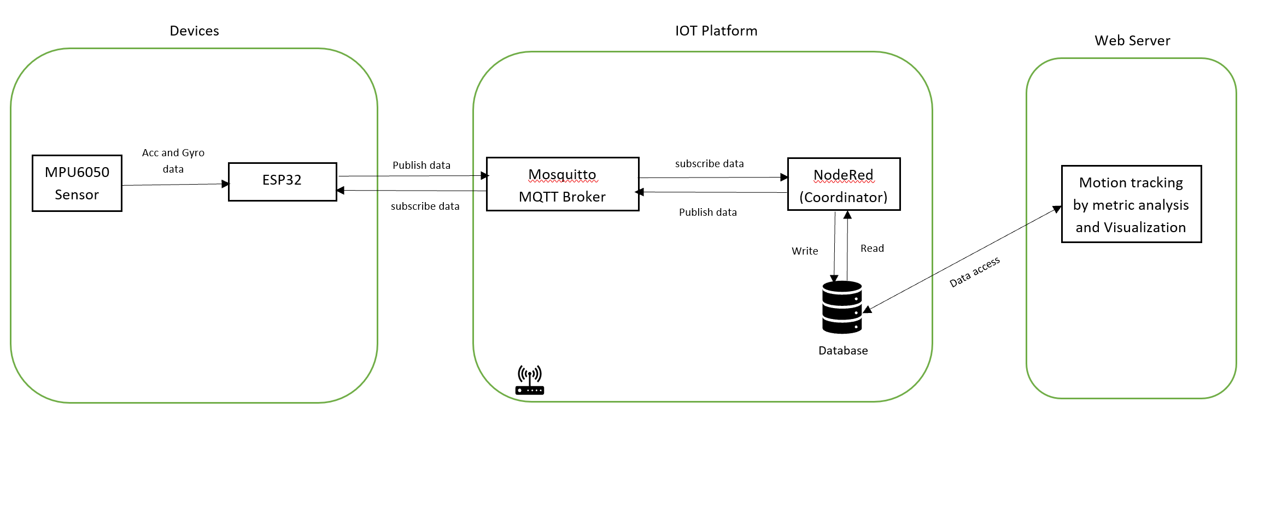
Overall IOT Architecture

Slide 6
Service specification
The following is the service specification for my project:
Input: The acceleration and gyroscope data obtained from the MPU6050 sensor serve as the system's input. The ESP32 device's MQTT publishing mechanism uses this data as its input.
Output: Motion tracking on a web application
Service: After receiving the messages sent out by the ESP32, the Node-Red adds a new row to the database. Because this HTTP server pulls data from a MySQL database, web services are used to analyze and visualize data live.
Endpoints: The ESP32 development module, the Node-Red service, the database, and the web server are the endpoints.

Slide 7
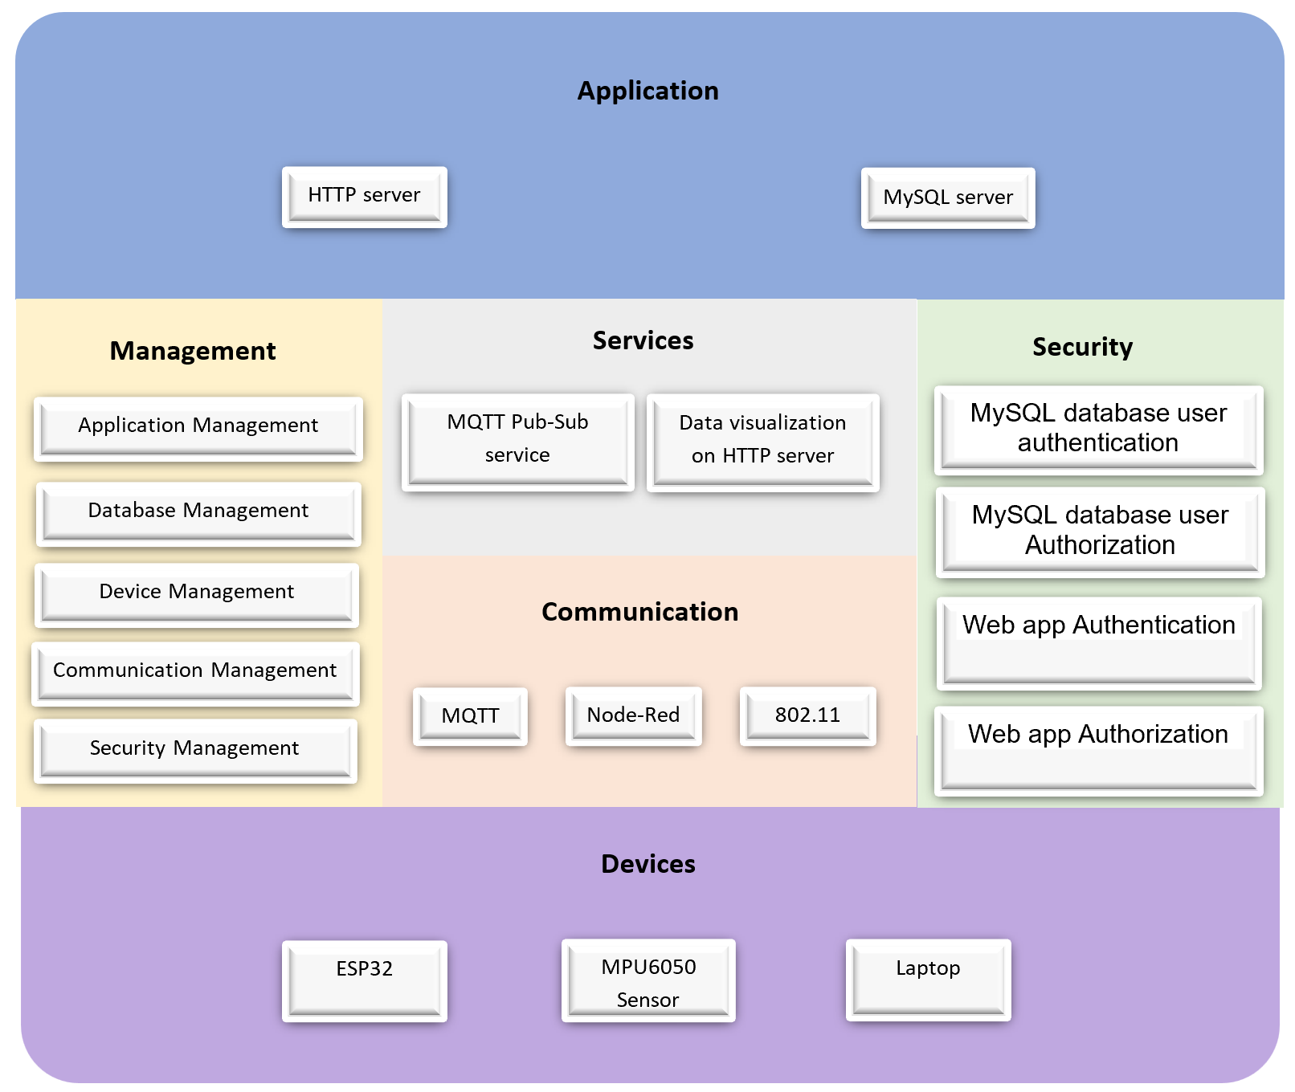
Functional View

Slide 8
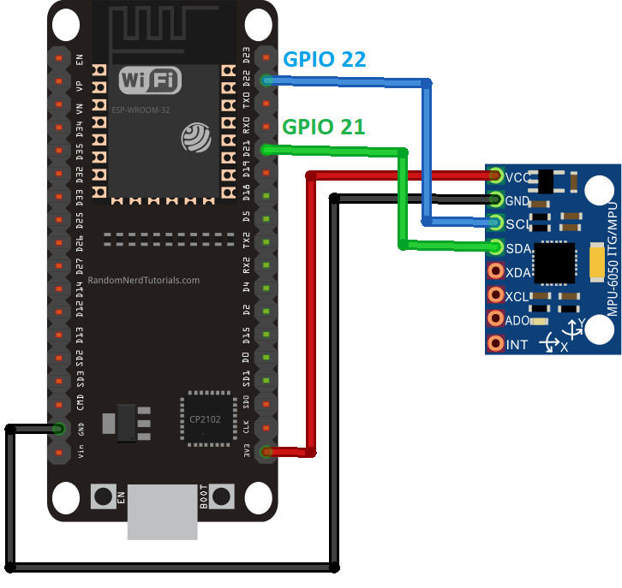
Component INtegration
Reference : https://randomnerdtutorials.com/esp32-mpu-6050-accelerometer-gyroscope-arduino/

Slide 9

ESP32-MQTT program
Setup WiFi connection using WiFi library
Establish connection to MQTT broker using pubsub library
Read the sensor data
Publish the sensor data to MQTT broker

Slide 10
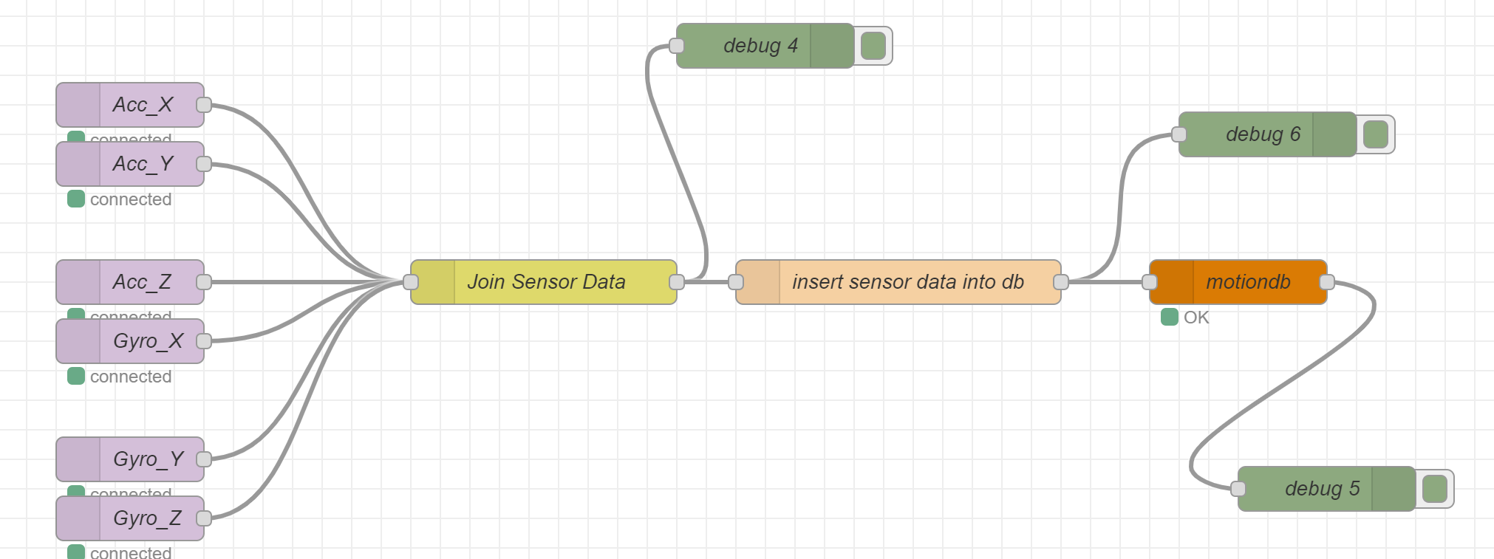
Node-Red Flow

Slide 11
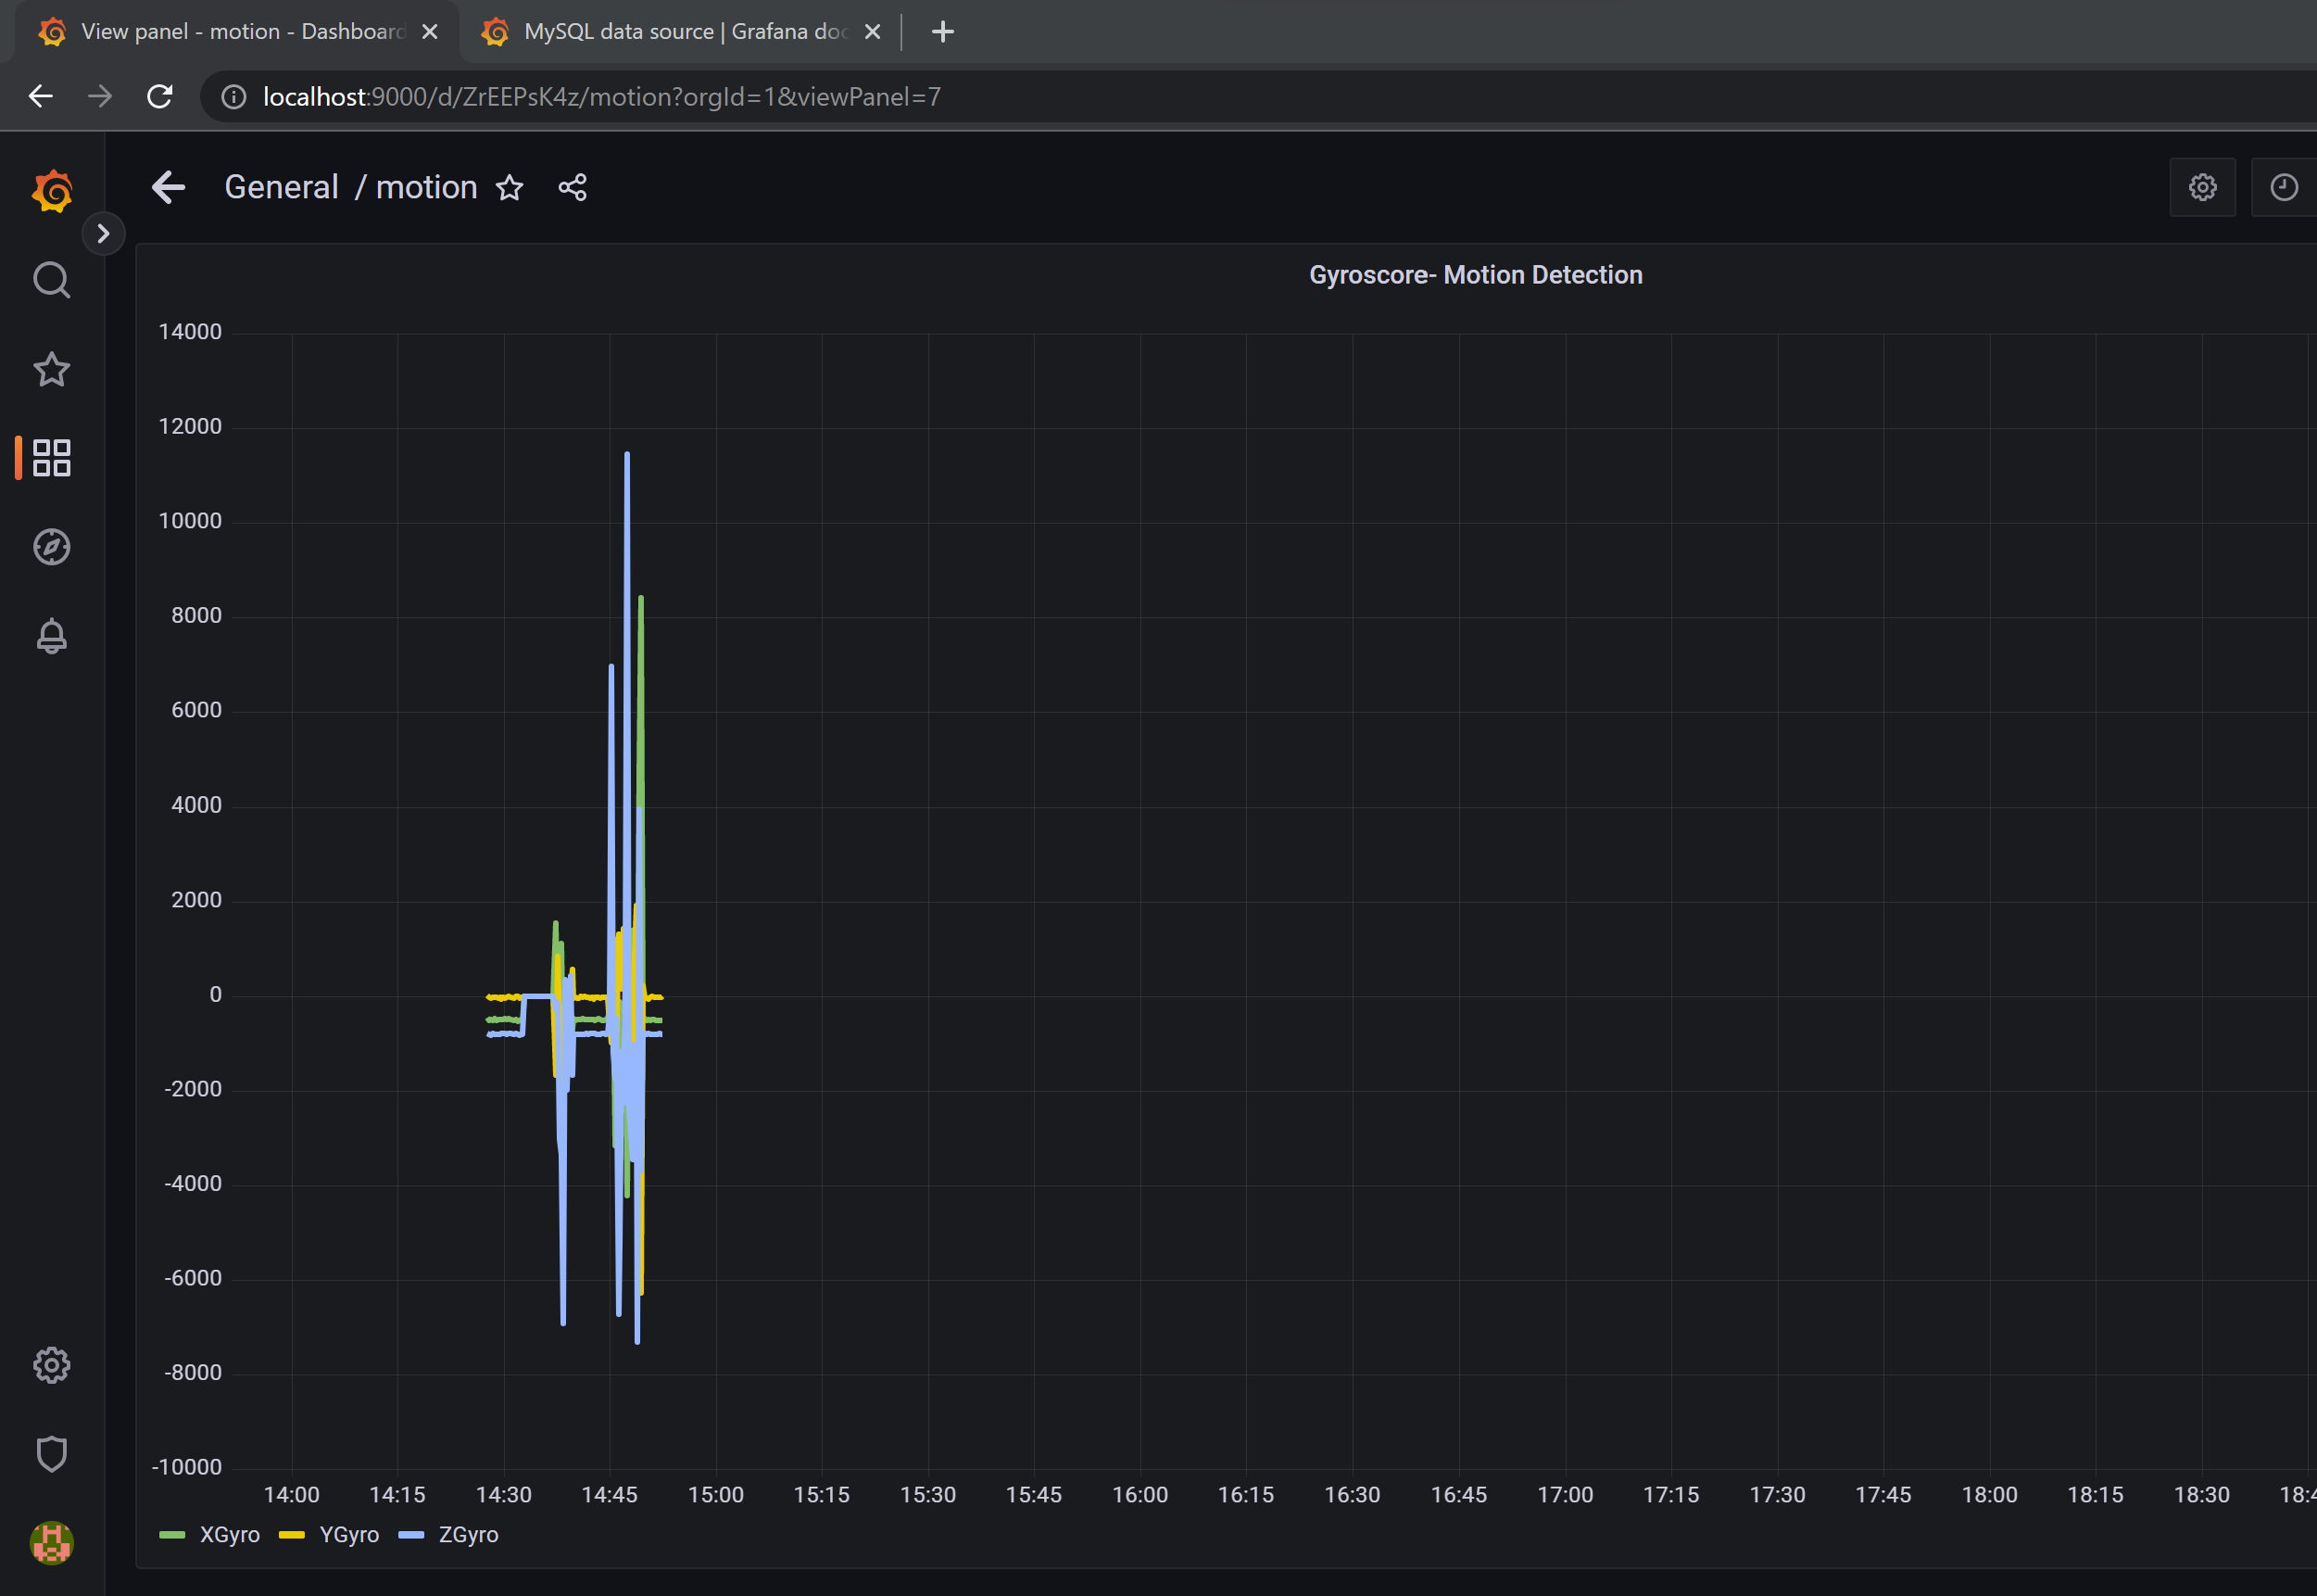
Web Application – Motion Tracking

Slide 12
References
https://www.researchgate.net/publication/251906191_Real-time_object_detection_and_tracking_on_a_moving_camera_platform
https://www.techopedia.com/definition/31558/motion-tracking
https://randomnerdtutorials.com/esp32-mpu-6050-accelerometer-gyroscope-arduino/
https://randomnerdtutorials.com/esp32-mpu-6050-accelerometer-gyroscope-arduino/
https://github.com/droidthings/IntrusionDetection/tree/master/Code/ESP32-MPU6050
https://discourse.nodered.org/t/mysql-node-red-table/7612/23
http://stevesnoderedguide.com/configuring-the-mqtt-publish-node
https://grafana.com/docs/grafana/latest/setup-grafana/configure-security/configure-authentication/grafana/
https://www.youtube.com/watch?v=d8eeNROMTv0
https://www.youtube.com/watch?v=72u6gIkeqUc

